Slide 1

Getting started in 3D Printing
Hardware store doesn’t have it? Make it yourself!

Slide 2
So, I am stuck on a spaceship. I only have 30 minutes to live……….

Slide 3
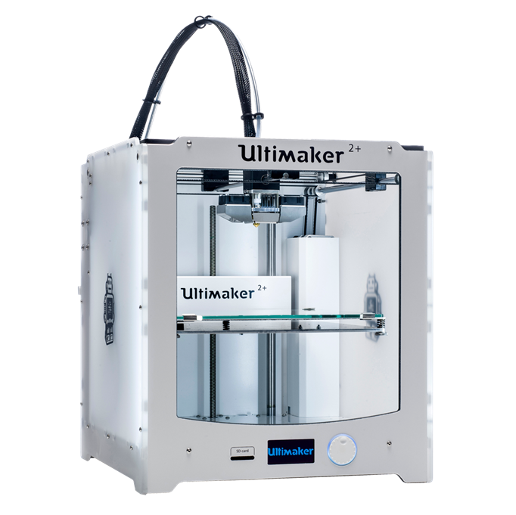
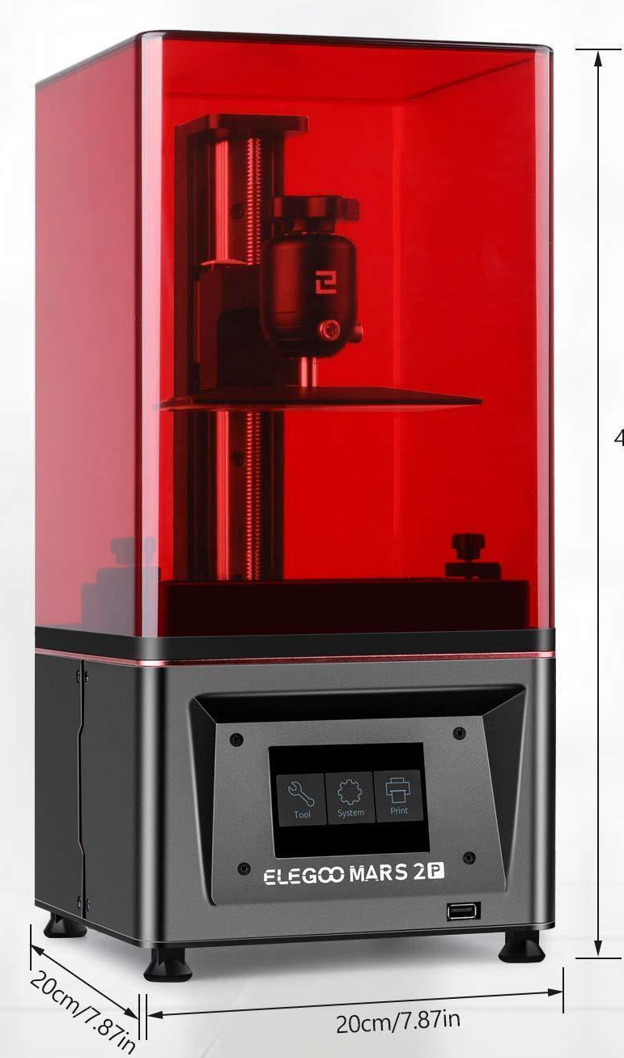
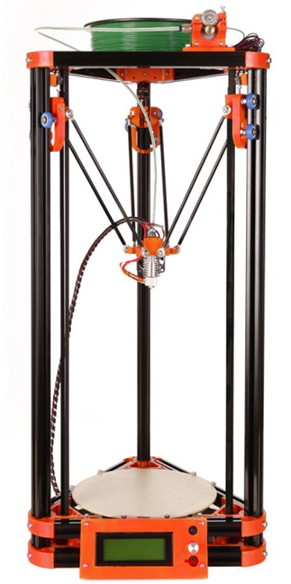
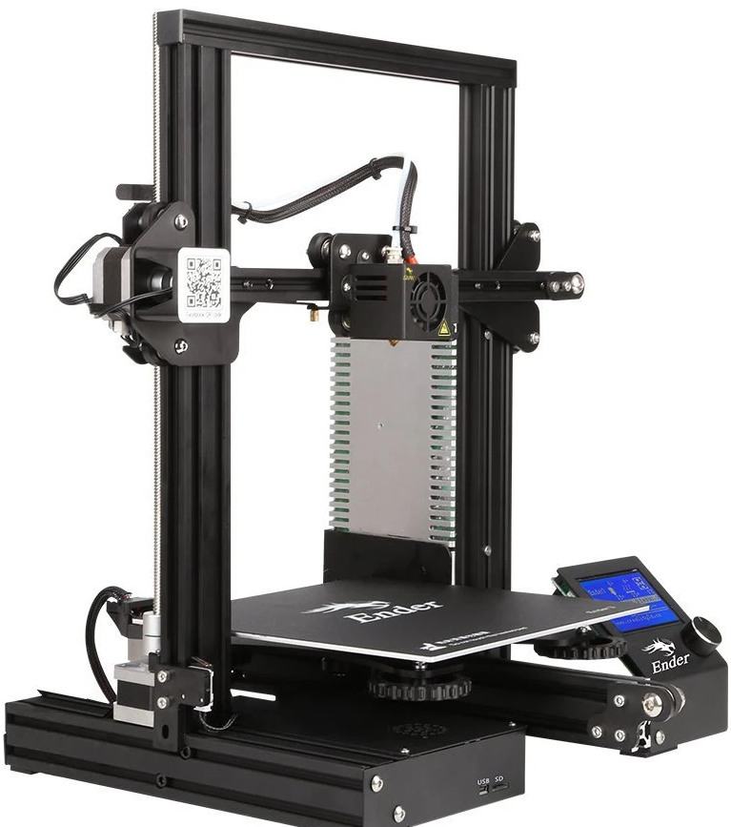
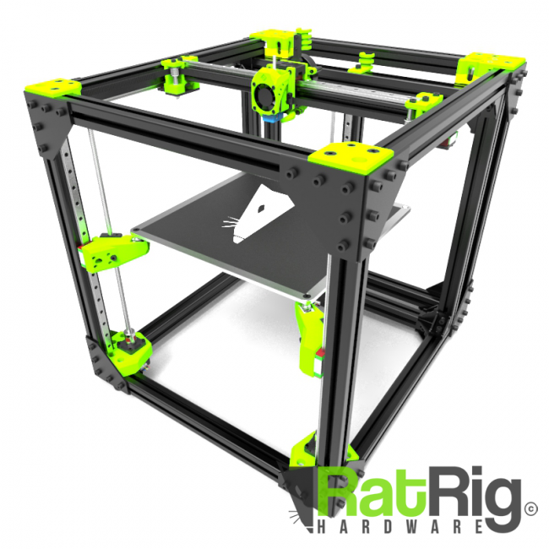
Step 1: Pick a printer
Ultimaker
Original Prusa MK3
Elegoo Mars 2 Pro
FLSUN Mini Kossel
Creality Ender 3

Slide 4
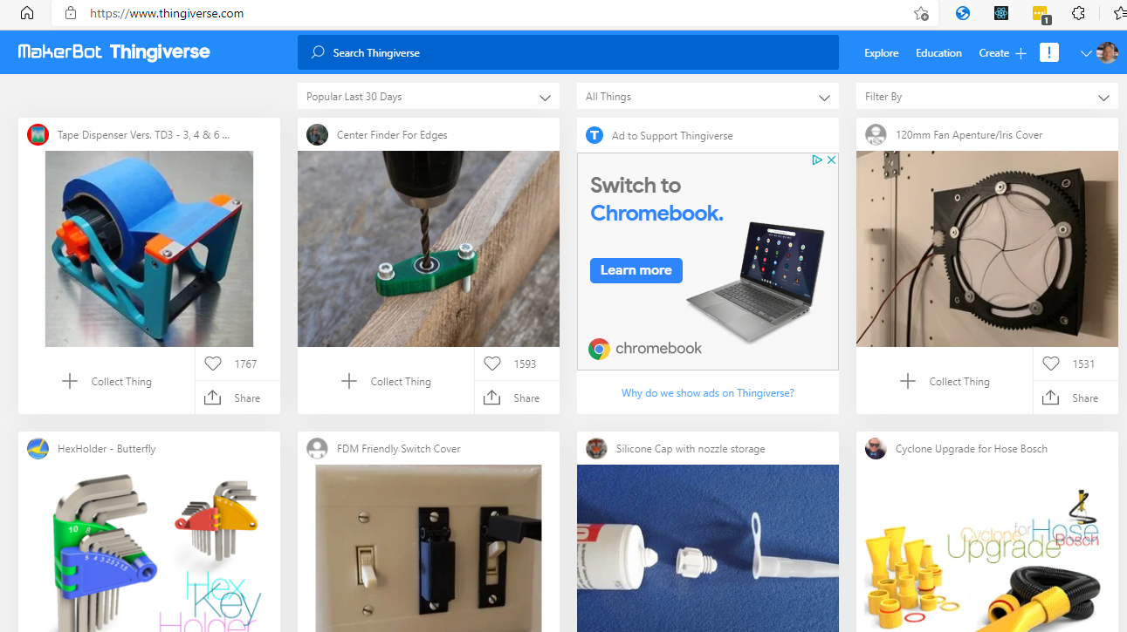
Step 2: Find something to print
https://www.thingiverse.com/

Slide 5
Or make it yourself
Fusion 360: https://www.autodesk.com/products/fusion-360/overview
Tinkercad: https://www.tinkercad.com/
OpenSCAD: http://www.openscad.org/
FreeCAD: https://www.freecadweb.org/

Slide 6
Step 3: Pick a filament
PLA
ABS
PETG
Resin?
Made from corn
Easy to print
Lots of colors
Most common
Lots of variants
Not good in the car during summer.
Cost: $10 - $20
Same stuff as Legos
More difficult to print
Tends to shrink
Stinky
Needs enclosure
Lots of colors
Durable
Keep out of sunlight
Cost: $15 - $25
Same stuff as water bottles
Can be “sticky”
Need to print slowly
Lots of really cool colors
Really stiff
Cost: $20 - #30
Messy
Requires cleanup after print
Cost $50 - $90

Slide 7

Step 4: Slice it up
Cura: https://ultimaker.com/en/products/cura-software
Silc3r: http://slic3r.org/
Craftware: https://craftunique.com/craftware/?page=craftware
Simplify 3D: https://www.simplify3d.com/

Slide 8

Step 5: Print it!
Any old SD card
From your PC
Octoprint: https://octoprint.org/

Slide 9
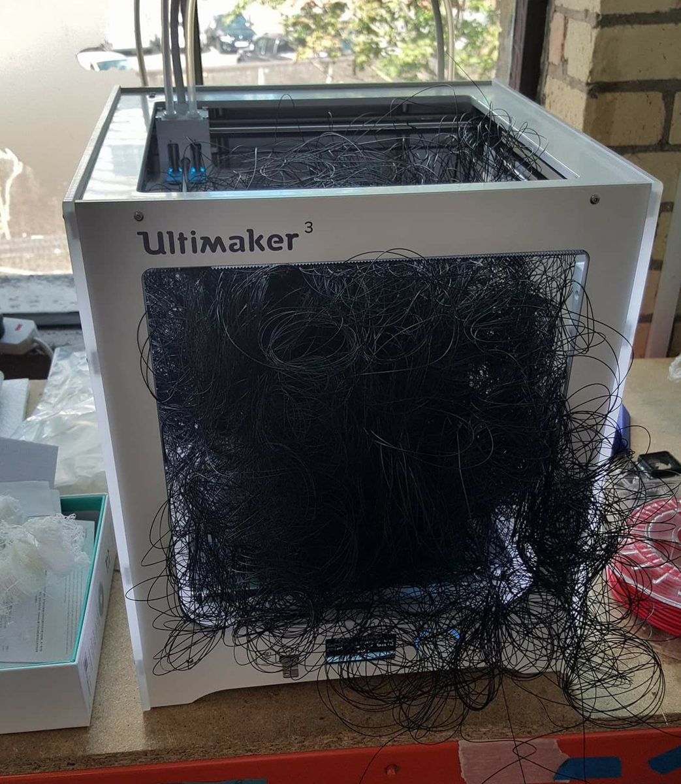
And hope you don’t get something like this:

Slide 10
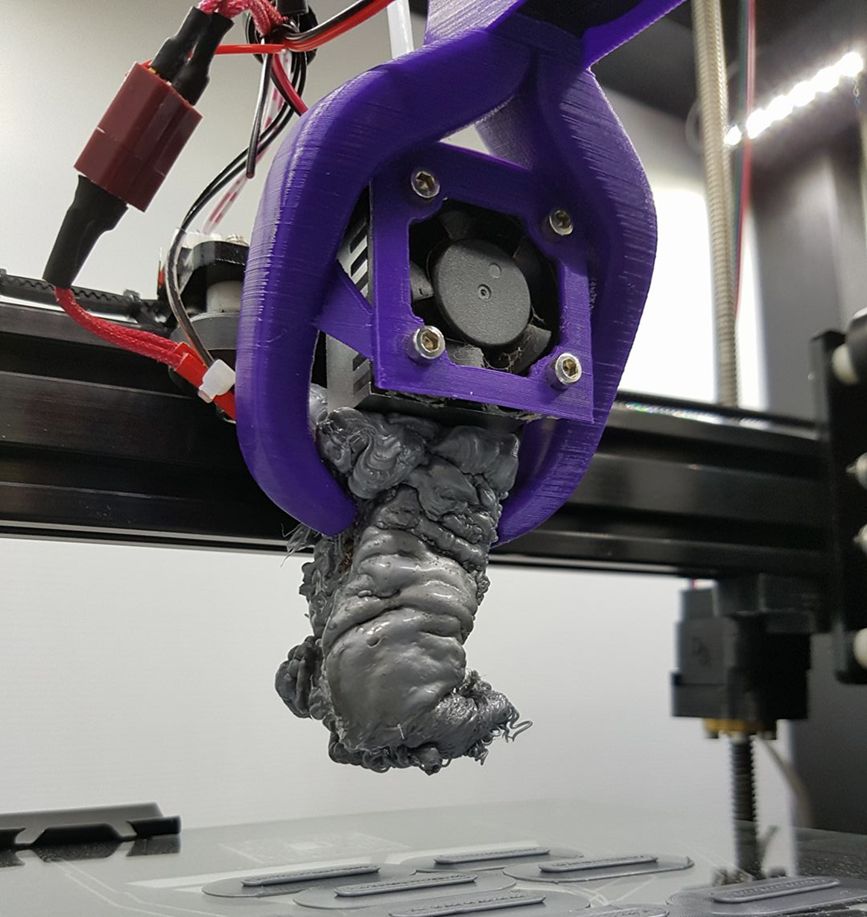
Or something like….

Slide 11

Is this stuff safe?

